Slide 1

River Oak Church & Charis Institute
Jim Sells Ph.D. and Jennifer Ripley Ph.D.

Slide 2

Why are we here?

Slide 3

Where Two individuals form an “Us”

Slide 4
Javier and Gina’s Rule of Life
We will commit to seeking God’s Kingdom first in all that we are and do. Our home will be a place where family, friends and guests find joy, comfort, peace and happiness. We will exercise wisdom in what we choose to eat, read and do in our home. We will learn to love another as we develop our own talents. We will exercise initiative in accomplishing our life’s goals. We will act on situations as opportunities, rather than to be acted upon. We will always try to keep ourselves free from addictive and destructive habits. We will develop habits that free us from old labels and limits and expand our capabilities and choices. Our money will be our servant, not our master. Our wants will be subject to our needs and means. We will honor God and choose to obey him every day of our lives.

Slide 5
Javier and Gina’s Rule of Life
We will commit to seeking God’s Kingdom first in all that we are and do. Our home will be a place where family, friends and guests find joy, comfort, peace and happiness. We will exercise wisdom in what we choose to eat, read and do in our home. We will learn to love another as we develop our own talents. We will exercise initiative in accomplishing our life’s goals. We will act on situations as opportunities, rather than to be acted upon. We will always try to keep ourselves free from addictive and destructive habits. We will develop habits that free us from old labels and limits and expand our capabilities and choices. Our money will be our servant, not our master. Our wants will be subject to our needs and means. We will honor God and choose to obey him every day of our lives.

Slide 6
Small Group Discussion
How did you meet as a couple?
What is your partner’s best character trait that you admire?

Slide 7
Colossians 3:1-4
¹Since, then, you have been raised with Christ, set your hearts on things above, where Christ is, seated at the right hand of God.
² Set your minds on things above, not on earthly things.
³ For you died, and your life is now hidden with Christ in God.
⁴ When Christ, who is your life, appears, then you also will appear with him in glory.

Slide 8
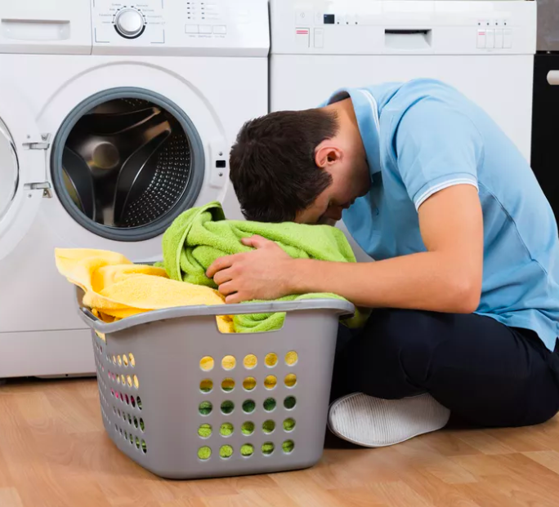
Laundry

Slide 9

The never ending list

Slide 10
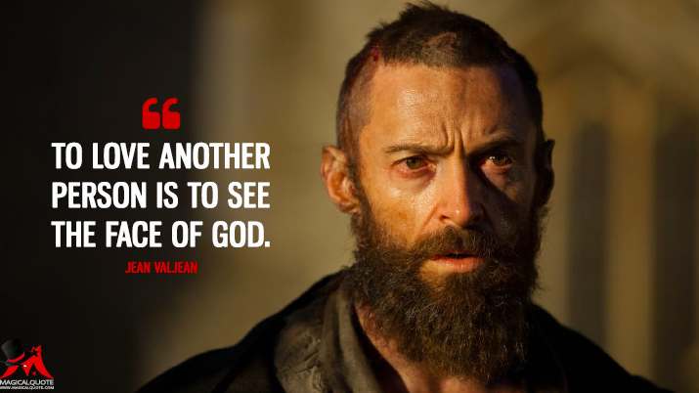

Slide 11
Scramble
Not yet married
Married 0-5 years
Married 5-10 years
Married 10-20 years
Married 21-30 years
Married +30 years

Slide 13
The Day Ahead
Us
Pain- Defense
Pain-Defense-Offense
Lunch
Grace
Love

Slide 14

The Two Months Ahead
The Bad News: 5 hours will not change the years of patterns in your relationship
The Good News: Small Group is powerful in helping people who are interested in growing their marriage.
Free 8-week small group
PLUS Daily activities to build new habits to cultivate a healthy marriage

Slide 15
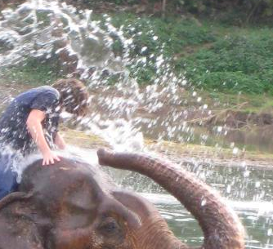
Who’s in charge?

Slide 16


Slide 17



Slide 18
Colossians 3:5-10
⁵ Put to death, therefore, whatever belongs to your earthly nature: sexual immorality, impurity, lust, evil desires and greed, which is idolatry.
⁶ Because of these, the wrath of God is coming.
⁷ You used to walk in these ways, in the life you once lived.
⁸ But now you must also rid yourselves of all such things as these: anger, rage, malice, slander, and filthy language from your lips.
⁹ Do not lie to each other, since you have taken off your old self with its practices
¹⁰ and have put on the new self, which is being renewed in knowledge in the image of its Creator.

Slide 19

Pain

Slide 20
Life Stressors
Him
Us
Her
Drained
Helpless

Slide 21
Break

Slide 22

Welcome Back
https://www.youtube.com/watch?v=X_TqDYY-dMw

Slide 23
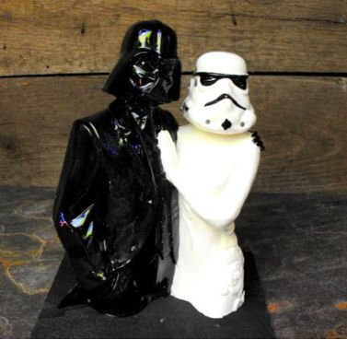
The best offense is a good Defense

Slide 24
Defense
Offense
Pain

Slide 25
Defense
Offense
Us
Pain
Pain
Offense
Defense

Slide 26
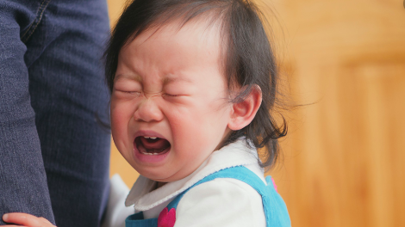

Slide 27
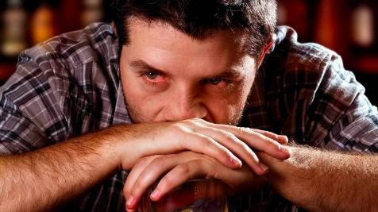

Slide 28


Slide 29


Slide 30


Slide 31
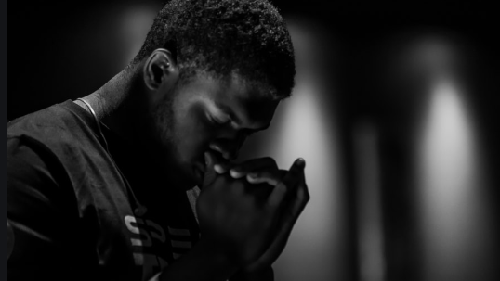

Slide 32
Defense
Offense
Us
Mike
Diane
Pain
Pain
Offense
Defense

Slide 33
Lunch

Slide 34
Grace Together

Slide 35
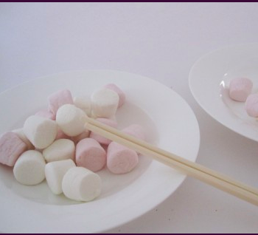
Minute to win it game

Slide 36
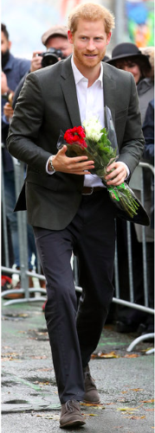
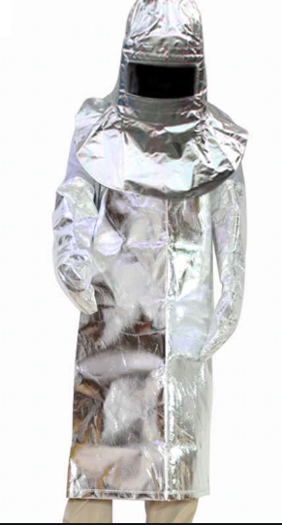

Slide 37
Colossians 3:12-13
¹² Therefore, as God’s chosen people, holy and dearly loved, clothe yourselves with compassion, kindness, humility, gentleness and patience.
¹³ Bear with each other and forgive one another if any of you has a grievance against someone. Forgive as the Lord forgave you.

Slide 38
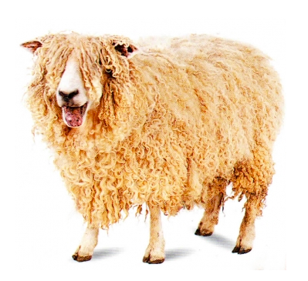


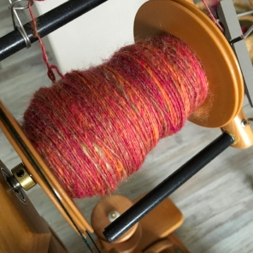

To get my clothes…

Slide 39
Cultivating a Healthy Marriage
Purpose
Peers
Practice

Slide 40
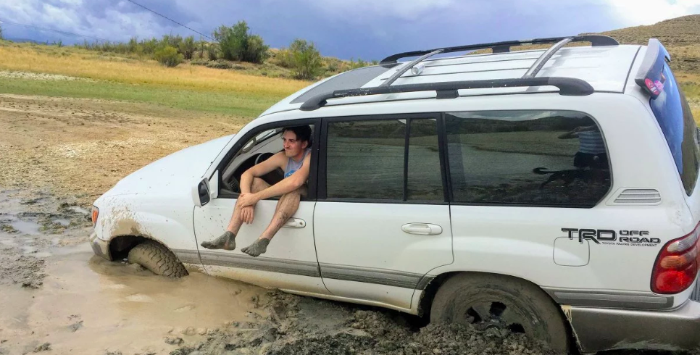

Slide 41


Slide 42
Break

Slide 43
Colossians 3:12-13
¹² Therefore, as God’s chosen people, holy and dearly loved, clothe yourselves with compassion, kindness, humility, gentleness and patience.
¹³ Bear with each other and forgive one another if any of you has a grievance against someone. Forgive as the Lord forgave you.

Slide 44
Colossians 3:14-17
¹⁴And over all these virtues put on love, which binds them all together in perfect unity.
¹⁵ Let the peace of Christ rule in your hearts, since as members of one body you were called to peace. And be thankful.
¹⁶ Let the message of Christ dwell among you richly as you teach and admonish one another with all wisdom through psalms, hymns, and songs from the Spirit, singing to God with gratitude in your hearts.
¹⁷ And whatever you do, whether in word or deed, do it all in the name of the Lord Jesus, giving thanks to God the Father through him.

Slide 45
The Formula
Raised with Christ
Mind and Heart set on Things Above
Identify the Pattern: Pain- Defense- Offense
Exercise the exchange of Grace
Clothe yourself with Good Things

Slide 46
Expression of Love

Slide 47
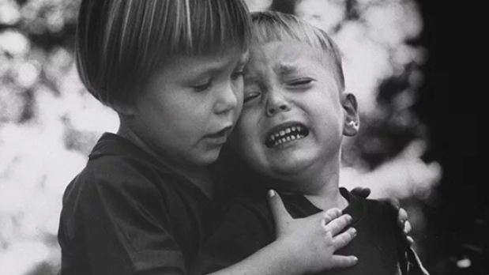
Compassion

Slide 48
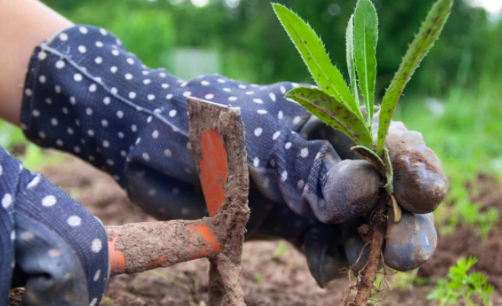

Control Weeds
Grow Roses

Slide 49
Colossians 3:12-13
¹² Therefore, as God’s chosen people, holy and dearly loved, clothe yourselves with compassion, kindness, humility, gentleness and patience.
¹³ Bear with each other and forgive one another if any of you has a grievance against someone. Forgive as the Lord forgave you.

Slide 50
Colossians 3:14-17
¹⁴And over all these virtues put on love, which binds them all together in perfect unity.
¹⁵ Let the peace of Christ rule in your hearts, since as members of one body you were called to peace. And be thankful.
¹⁶ Let the message of Christ dwell among you richly as you teach and admonish one another with all wisdom through psalms, hymns, and songs from the Spirit, singing to God with gratitude in your hearts.
¹⁷ And whatever you do, whether in word or deed, do it all in the name of the Lord Jesus, giving thanks to God the Father through him.

Slide 51

What I always wanted

Slide 52
Small Group Planning
When
Where
Kids? Food?

Slide 53

Rose Ceremony

